Slide 1



GeoClean SJ
Clean Up Your City
GRAFFITI ROADKILL TRASH
By Zoya, Harini, and Aisha

Slide 2
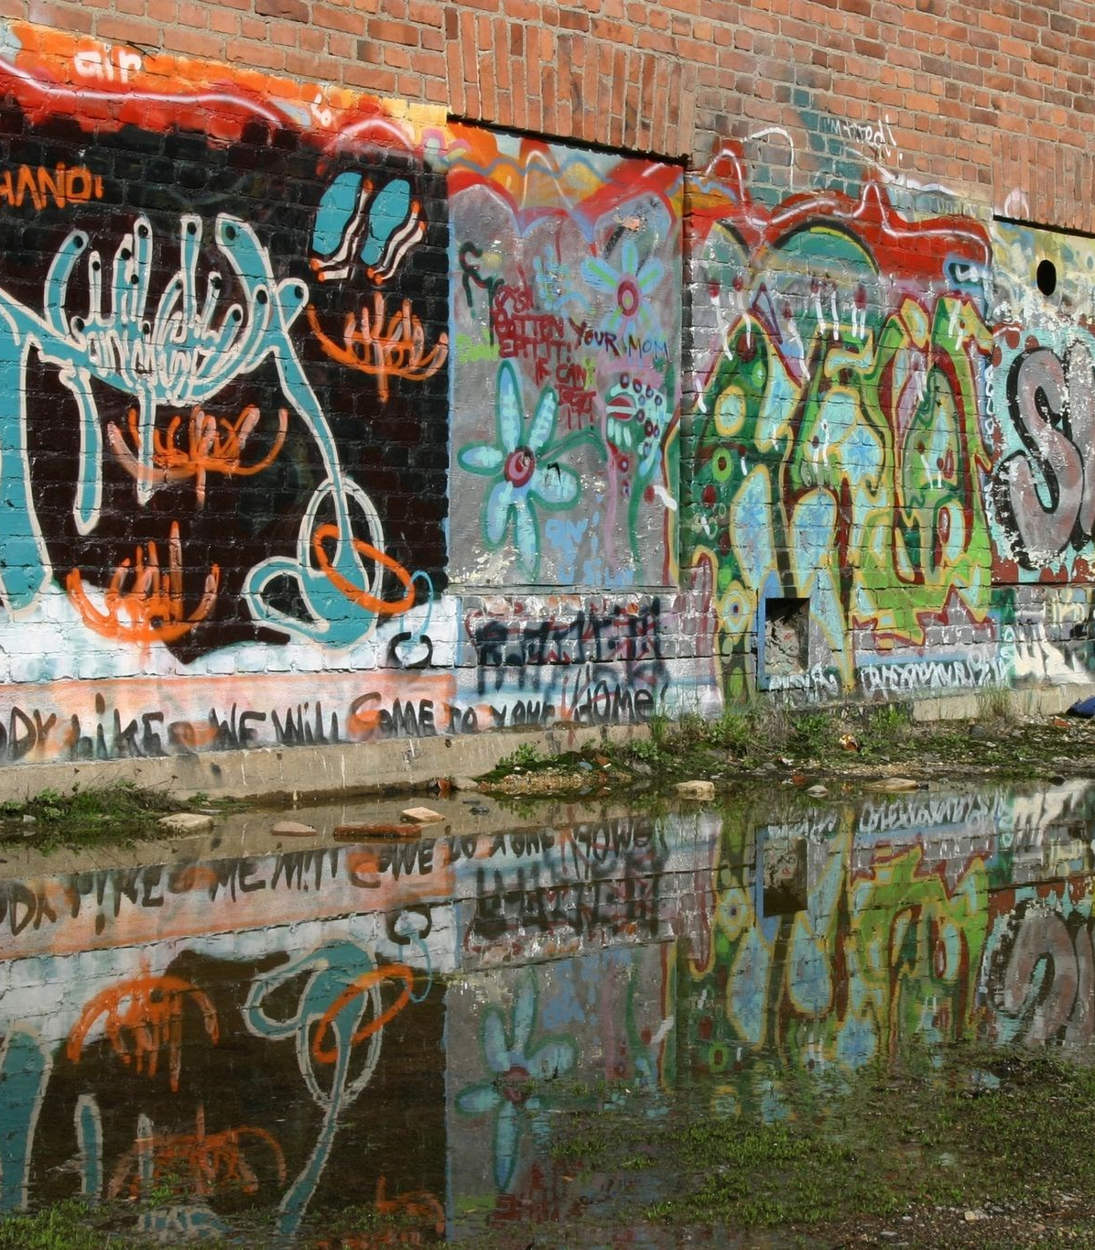
the problem
According to the City of San Jose website, street sweeping happens once a month, and graffiti removal takes 1-3 business days.
Current graffiti reporting process relies on citizens manually submitting complaints, causing slower response times.
Roadkill, trash, and graffiti are often left unattended for long periods of time before being removed.
San José needs a proactive, automated system to maintain cleanliness more efficiently and cost-effectively.

Slide 3
our solution
Real-time image analysis using machine learning (YOLO) to detect graffiti, trash, and debris.
Captures images from surveillance cameras or mobile patrol vans throughout the city.
Automatically flags and highlights issues in uploaded or camera-feed images.
Sends immediate alerts to city maintenance teams for faster action.
Maps incidents with timestamps and locations to optimize resource planning.

Slide 4

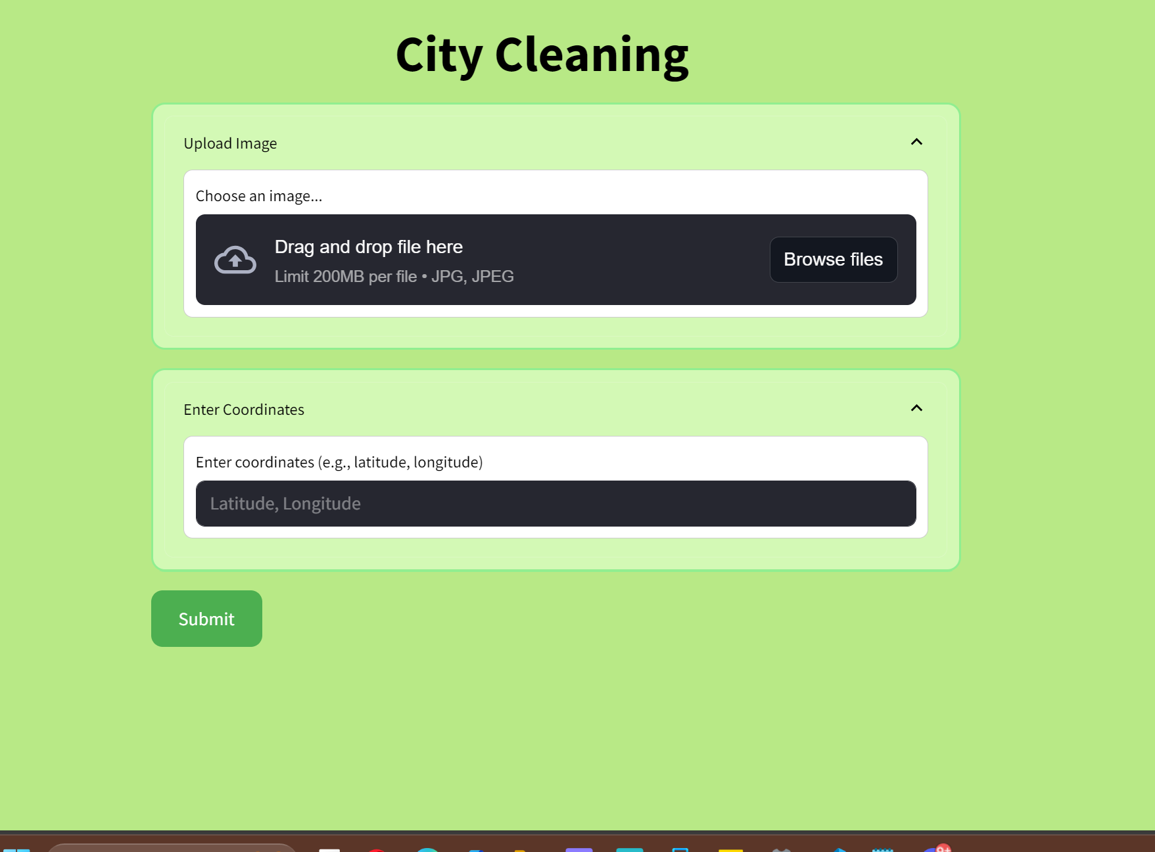
how GeoClean SJ works
1. Upload an Image
Users upload images taken from smartphones, city vans, or surveillance cameras of urban areas through a simple web interface.
2. AI Model Prediction
A custom-trained Deep Learning model (best.pt) identifies 6 classes of pollution:
Birds, Roadkill, Trash (Objects), Graffiti, Potholes, Weeds.
The uploaded image is preprocessed (resized, normalized) and passed to the model to predict the type of issue.

Slide 5



how GeoClean SJ works
3. Display Results
Predicted pollution type
Exact location
Image preview and metadata
4. Enable City Action
All reports feed into a centralized dashboard for government and organizations to view, prioritize, and act on environmental issues in real-time.

Slide 6




impact on san jose
faster response
save costs
data driven decisions
supports existing programs
Issues are detected and dispatched to crews within minutes.
Cuts down on manual patrolling and inspection labor.
Helps the city identify repeat problem zones and plan preventive measures in the long term.
Strengthens initiatives like BeautifySJ, Anti-Graffiti Program, and the FAST proactive cleanup team.
Can be integrated with San José 311 to enhance community engagement.

Slide 7
implementation

Slide 8
see the app work! **NOT LIVE RIGHT NOW**
Click the link: https://rich-windows-bet.loca.lt/
Put in the tunnel password: 35.201.230.33
Upload a image of city pollution
The app should be able to identify it!
*tunnel might time out due to inactivity and connection issues

Slide 9
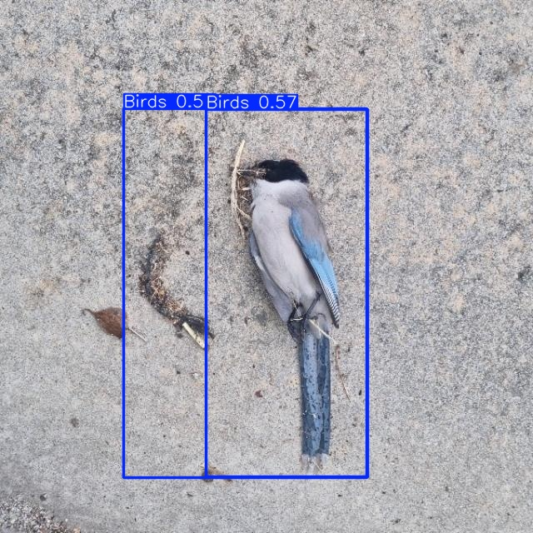
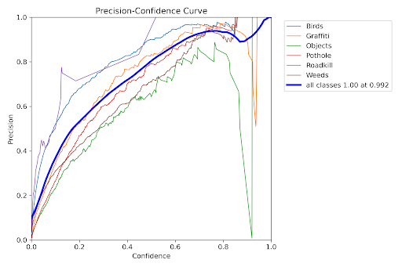
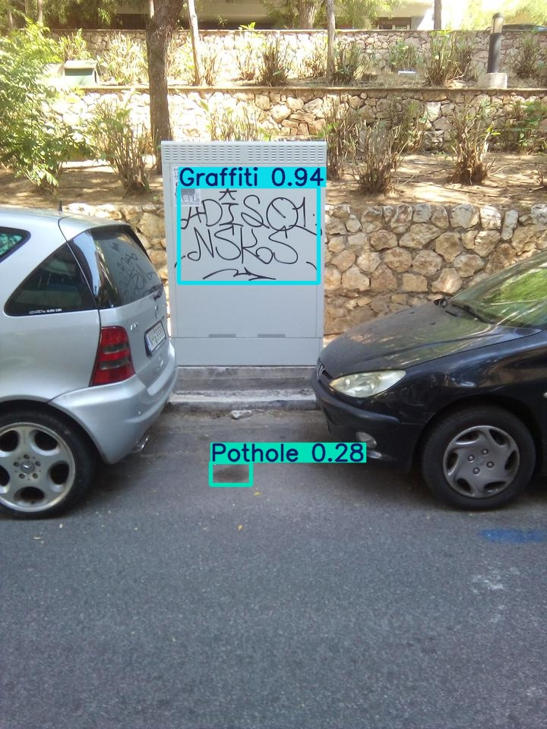
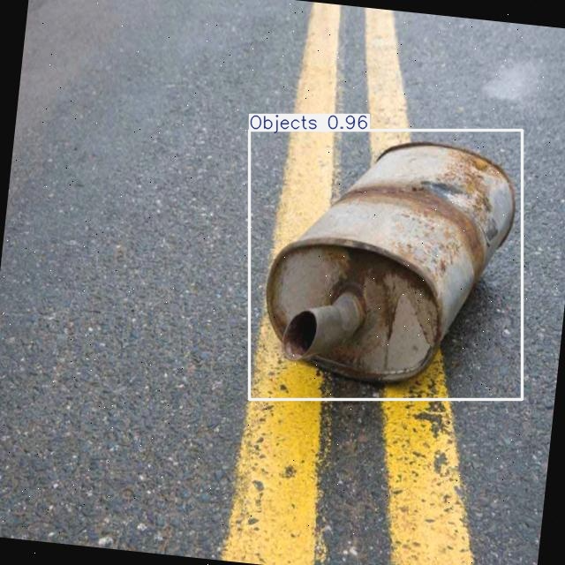
see the app work!

Slide 10
video
demo

Slide 11
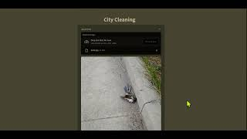

Slide 12
references
Street Sweeping | City of San José
STORM graffiti/tagging detection dataset
https://universe.roboflow.com/hind-althabi/road-debris-iya6s/dataset/3
crop and weed detection data with bounding boxes
https://www.kaggle.com/datasets/andrewmvd/pothole-detection
https://universe.roboflow.com/capstone-48zdu/roadkill2
https://www.nbcbayarea.com/news/local/south-bay/san-jose-streets-traffic-cameras/3698734/

Slide 13
thank
you!

